Slide 1
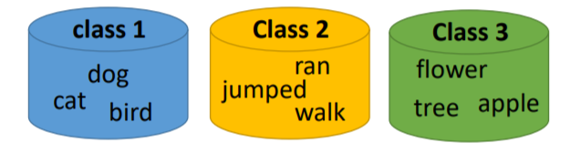
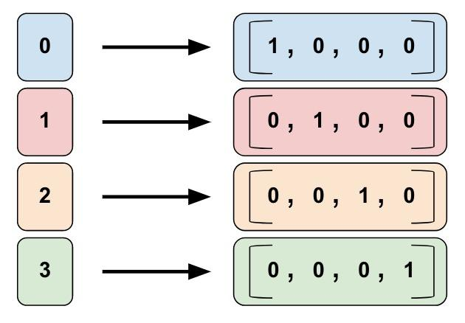
词的编码方式
2. Word Class：将词分类表示。例如 动物 分一类，生活用品 分一类，使用类似One-hot的方法来表示词的分类
Word Class 的缺点：不同类之间没有关系
1. One-hot Encoding: 将每一个词编码向量，向量长度为词的个数 (N)，其中有一个1，其余元素都是0。1的不同位置体现了两个词的不同。One-hot Encoding 的缺点：任意两个向量之间都没有关系，例如：one-hot编码方式认为 猫 和 狗 的区别与 猫 和 牙刷 的区别是相同的。
3.词嵌入(Word Embedding)：auto-Encoder：一个基于深度学习的降维方法：学习一个 input=output 的神经网络，然后将某一个hidden layer取出来作为编码。
其他的网络结构：
CBOW：使用第 i-1 和第 i+1个词来预测第 i 个词
Skip-gram：使用第 i 个词来预测第 i-1 和第 i+1 个词

Slide 2

矩阵和向量
Linear Algebra review (optional)
Machine Learning

Slide 3
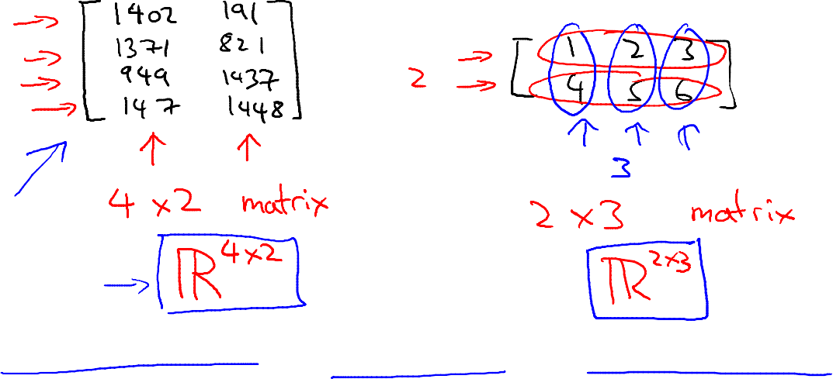
Matrix: Rectangular array of numbers:
Dimension of matrix: number of rows x number of columns

Slide 4
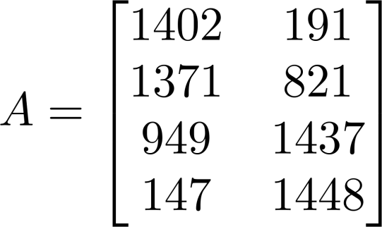
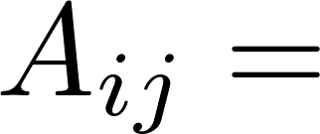

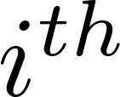

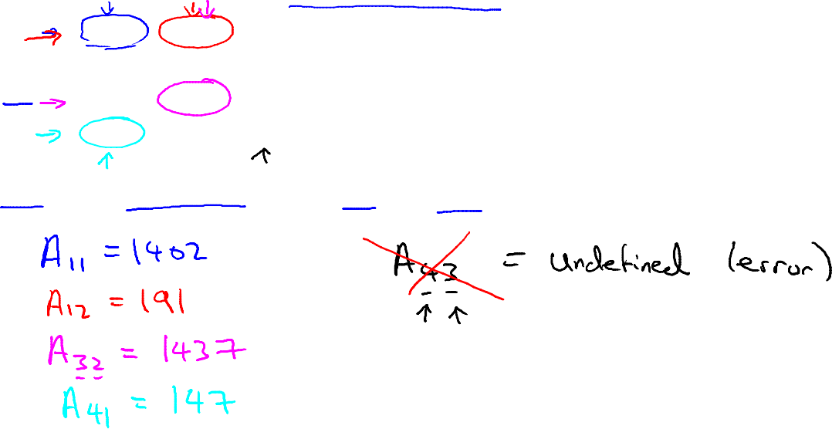
Matrix Elements (entries of matrix)
“ , entry” in the row, column.

Slide 5
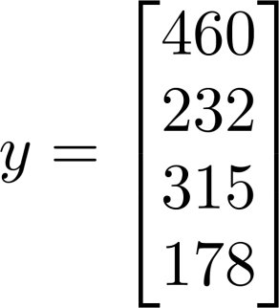
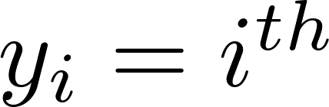
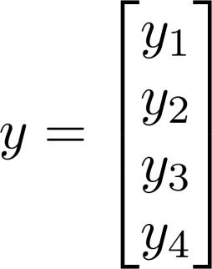
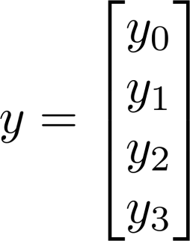
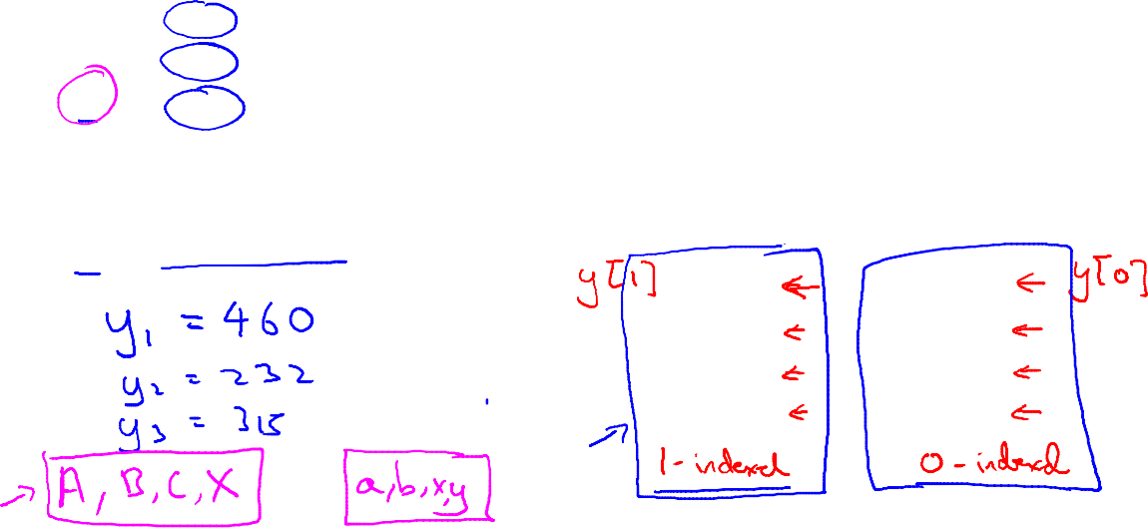
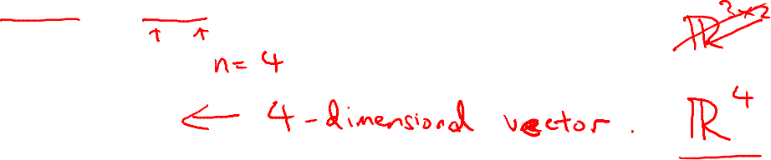
Vector: An n x 1 matrix.
1-indexed vs 0-indexed:
element
n-dimensional vector

Slide 6
加法和标量乘法
Linear Algebra review (optional)
Machine Learning

Slide 7
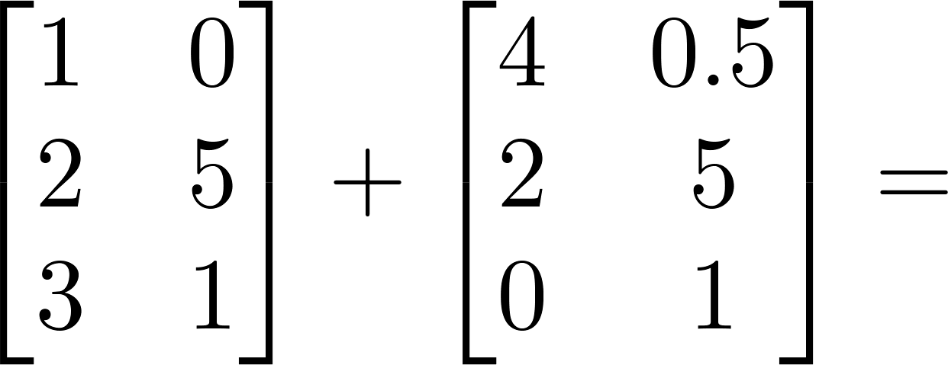
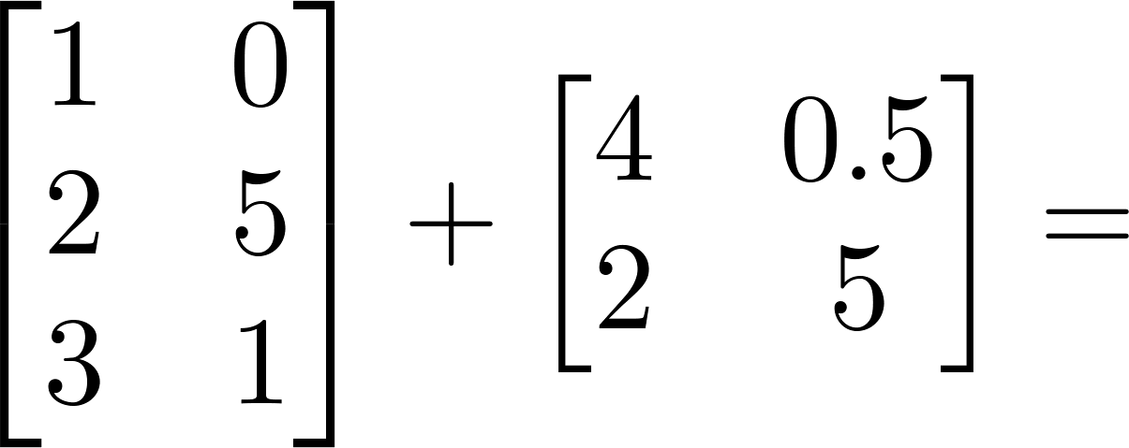
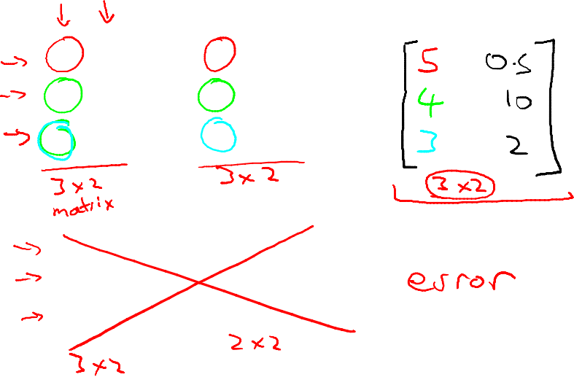
Matrix Addition

Slide 8
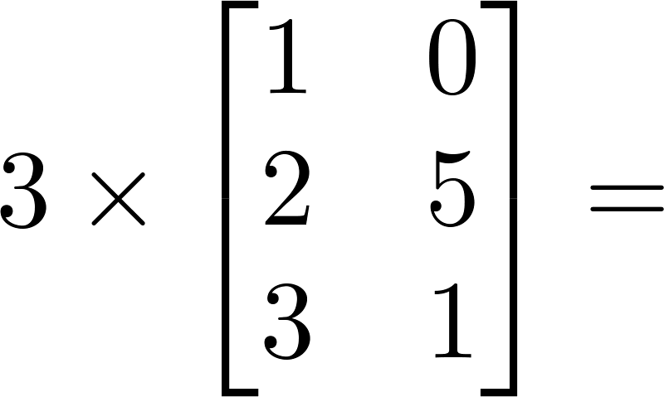
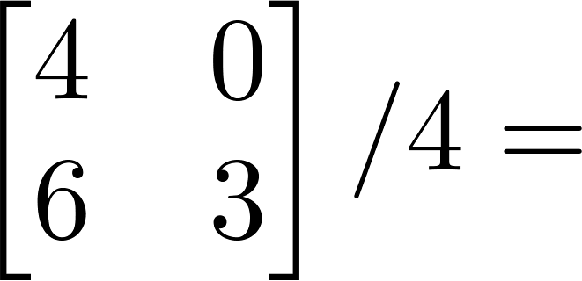
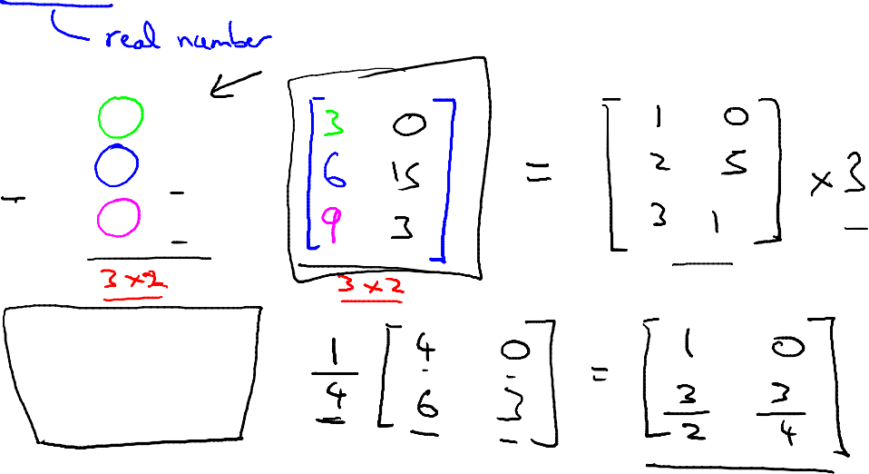
Scalar Multiplication

Slide 9
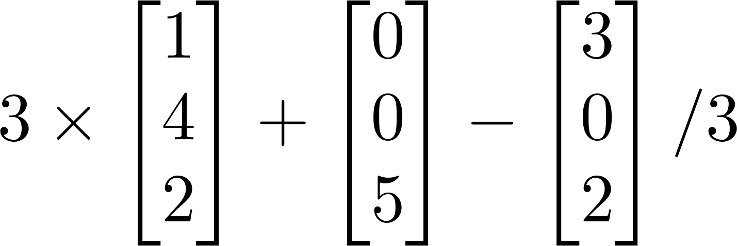
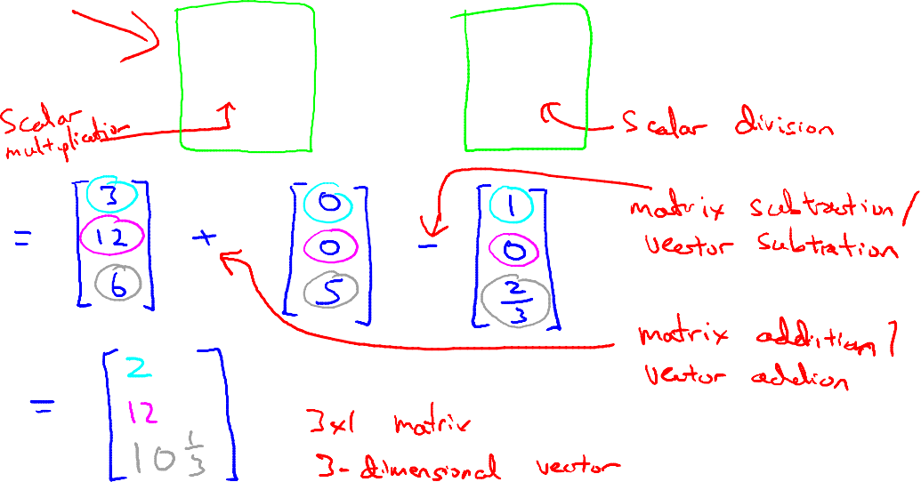
Combination of Operands

Slide 10
矩阵向量乘法
Linear Algebra review (optional)
Machine Learning

Slide 11
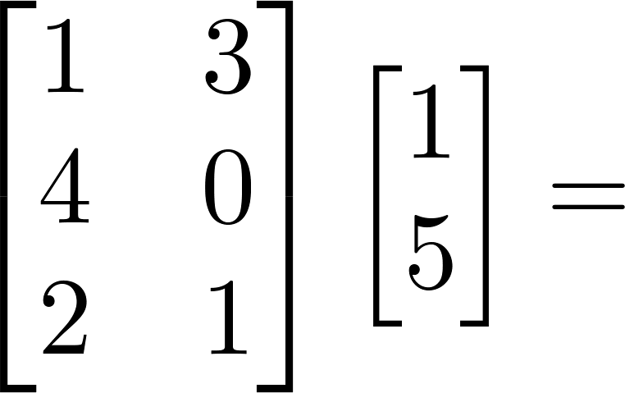
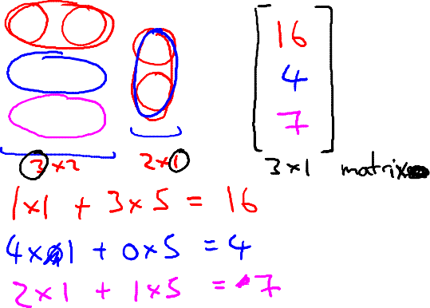
Example

Slide 12
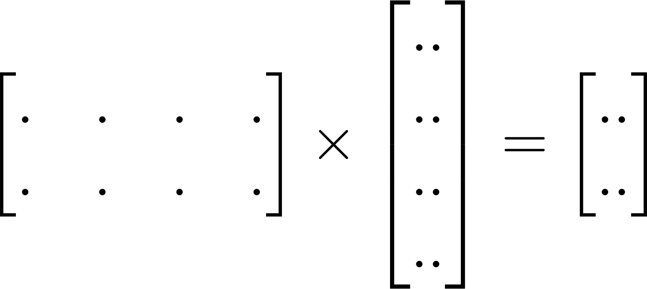
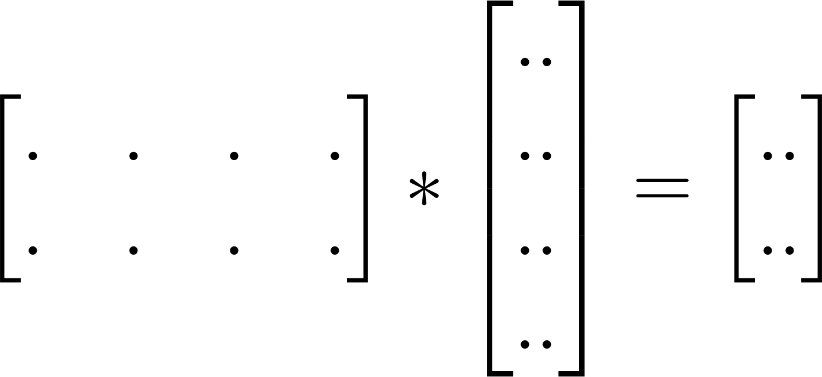



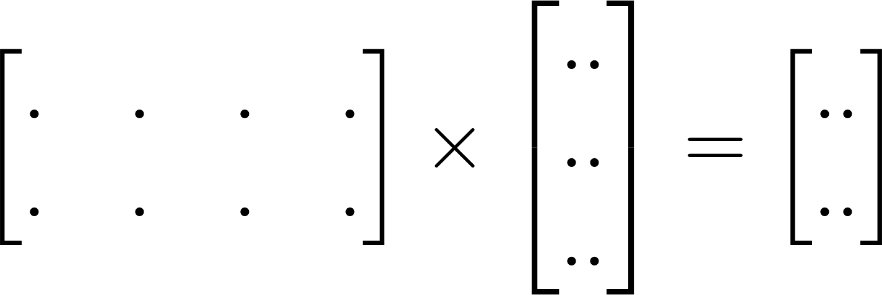

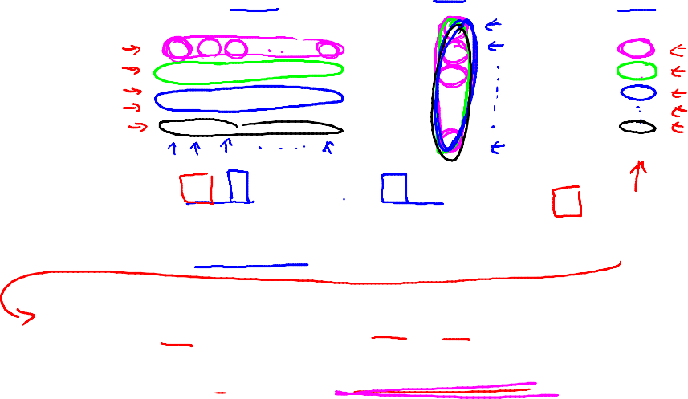
Details:
m x n matrix
(m rows,
n columns)
n x 1 matrix
(n-dimensional
vector)
m-dimensional vector
To get , multiply ’s row with elements of vector , and add them up.

Slide 13
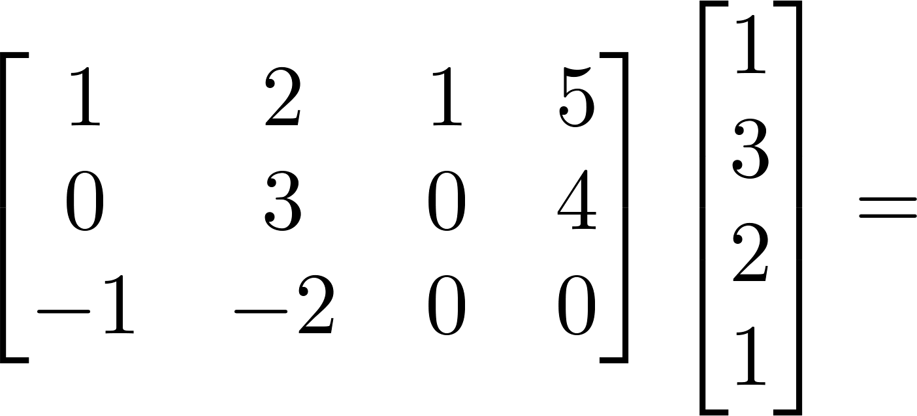
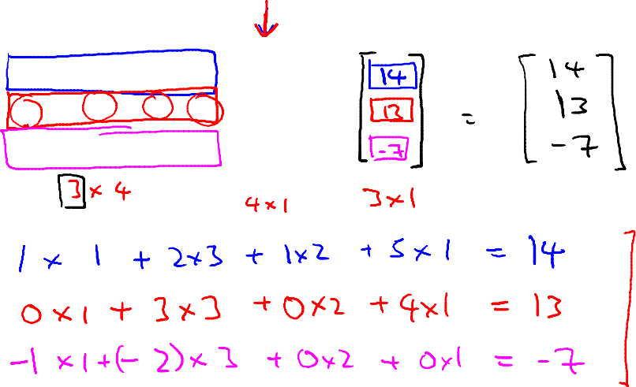
Example

Slide 14
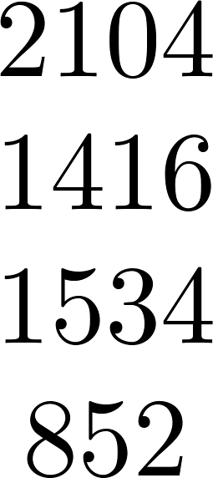
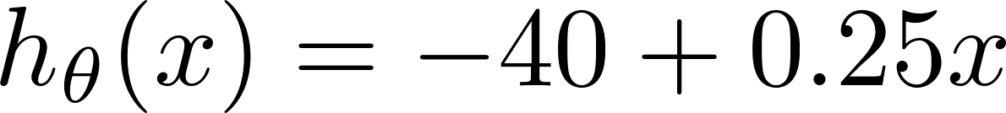
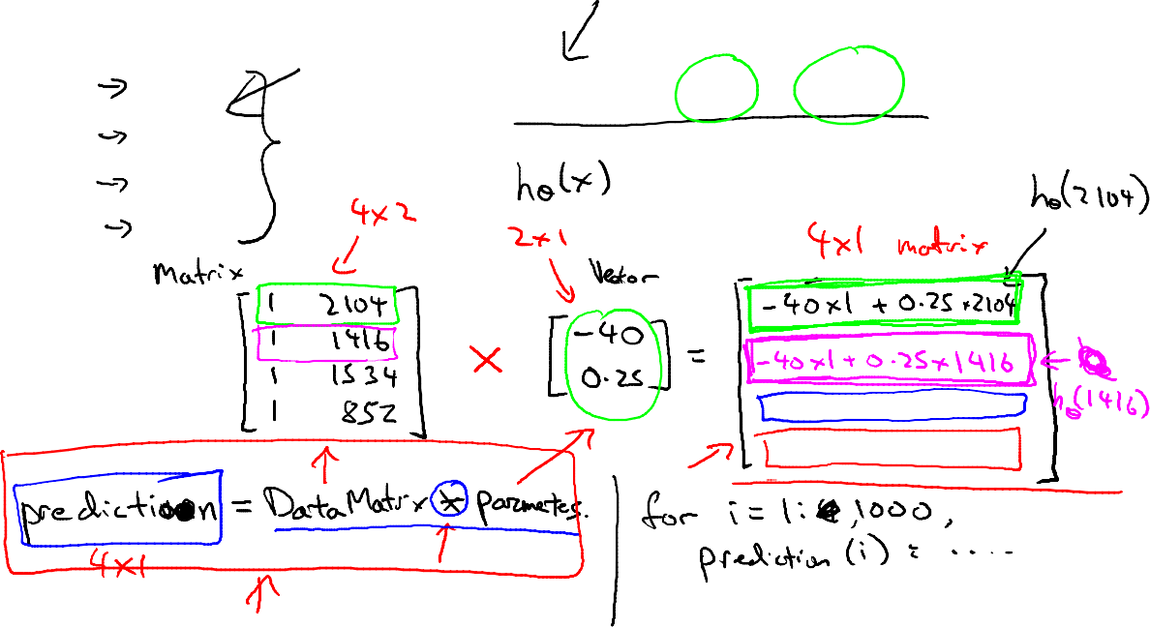
House sizes:

Slide 15
矩阵与矩阵的乘法
Linear Algebra review (optional)
Machine Learning

Slide 16
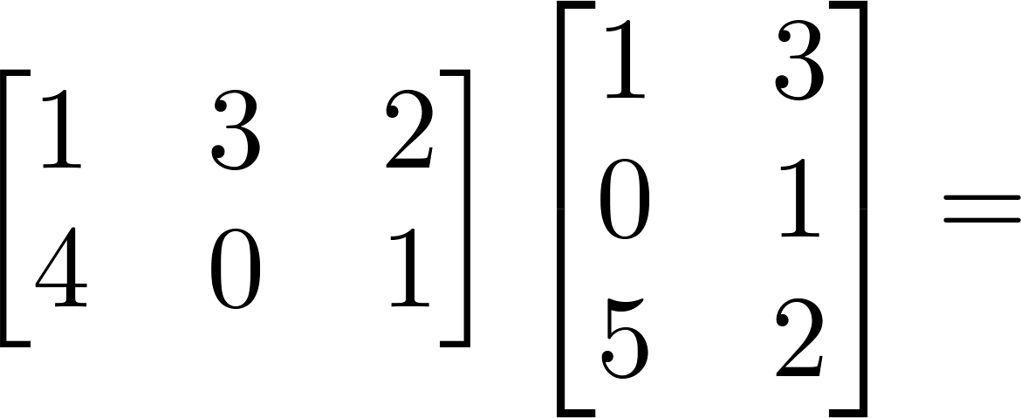
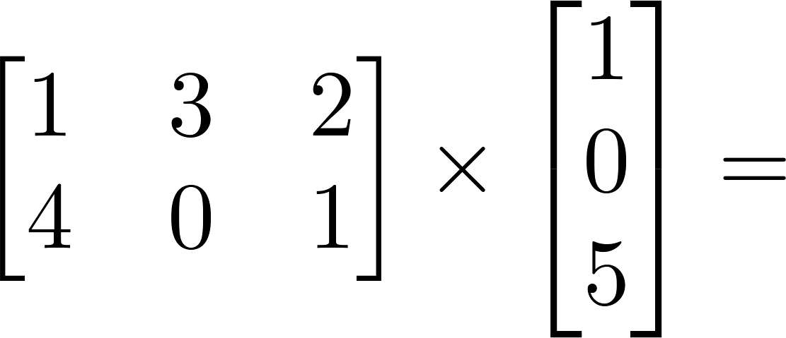
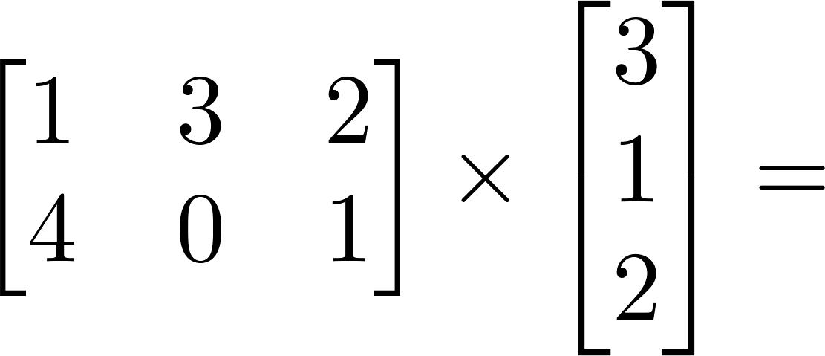
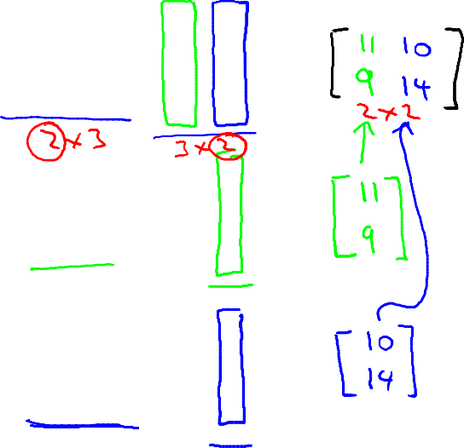
Example

Slide 17


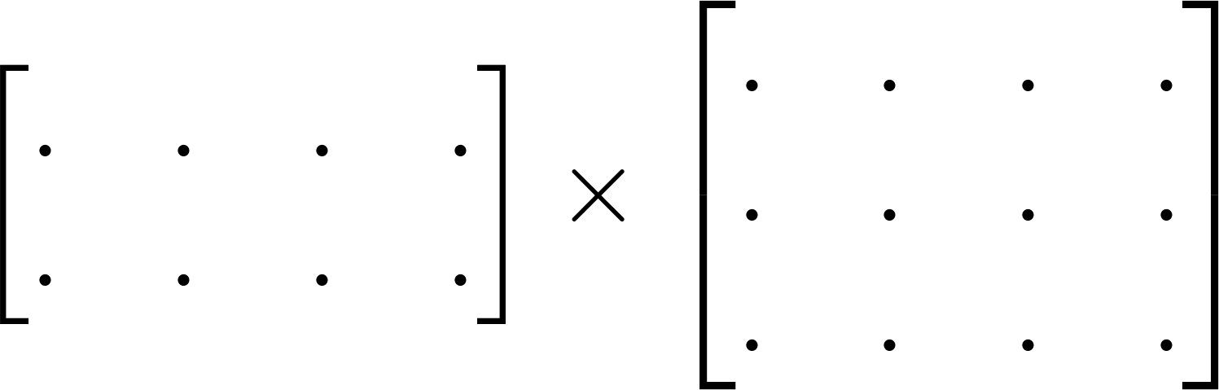
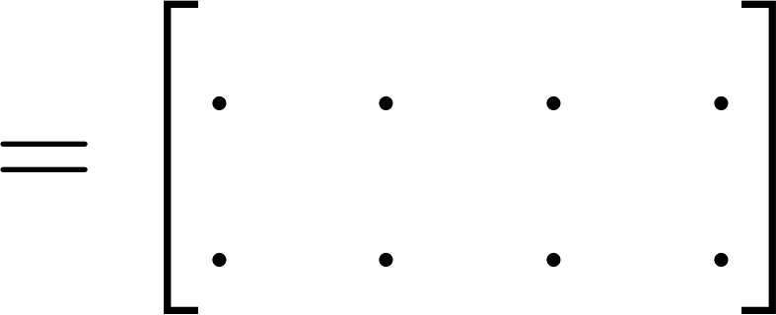

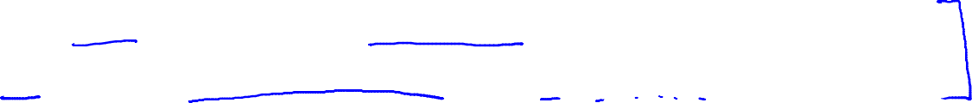
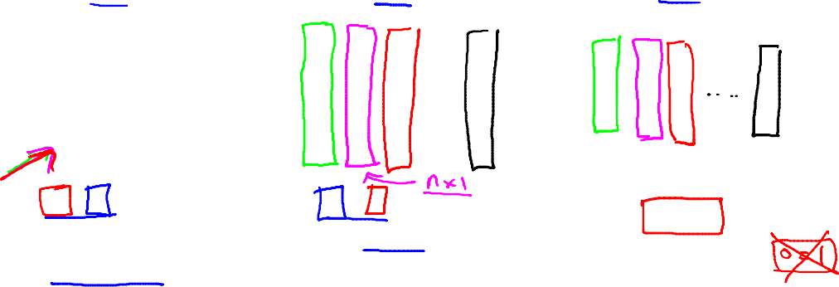
Details:
m x n matrix
(m rows,
n columns)
n x o matrix
(n rows,
o columns)
m x o
matrix
The column of the matrix is obtained by multiplying
with the column of . (for = 1,2,…,o)

Slide 18
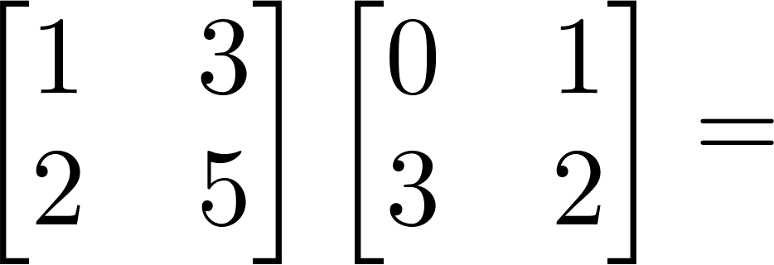
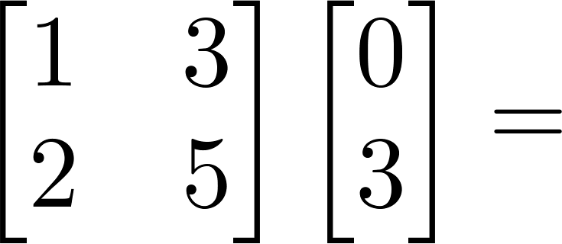
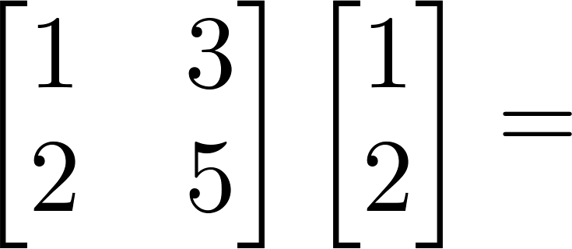
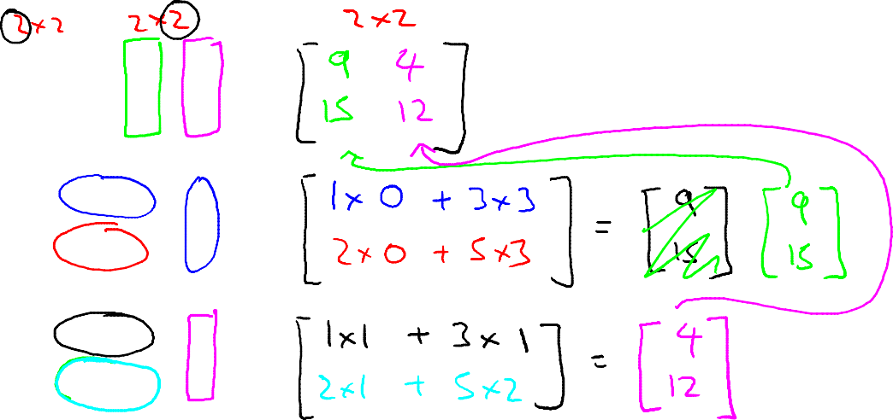
Example
7
2
7

Slide 19
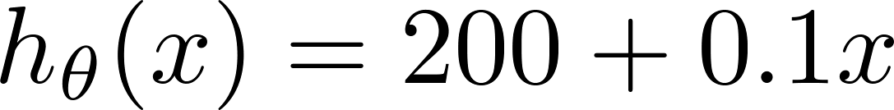
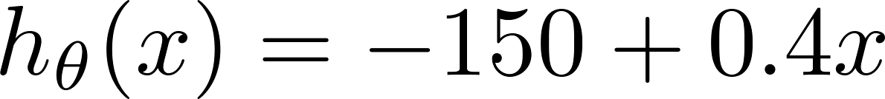
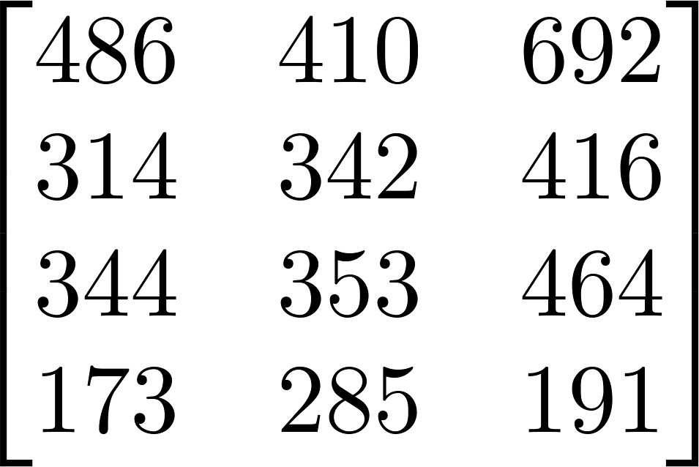
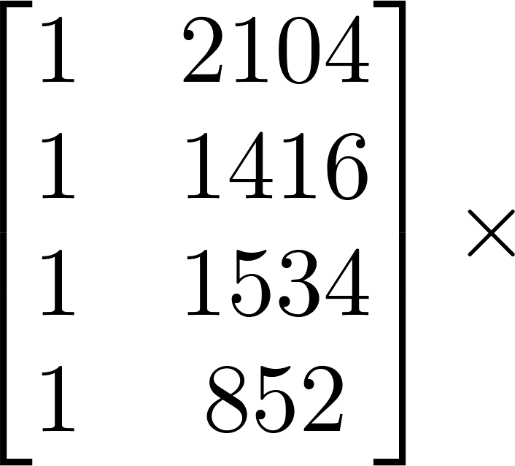
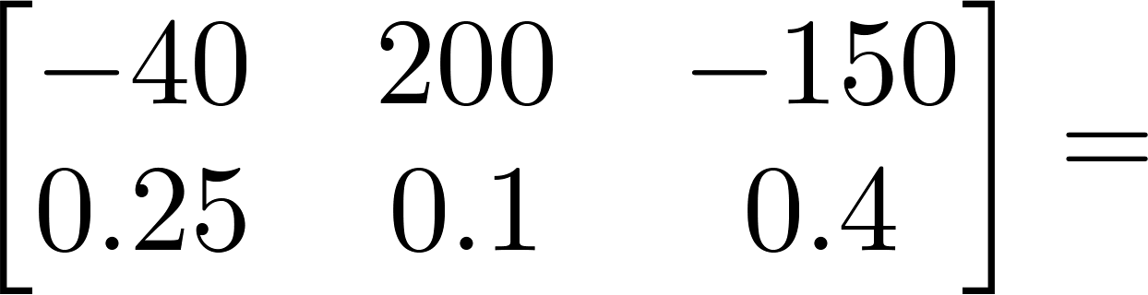
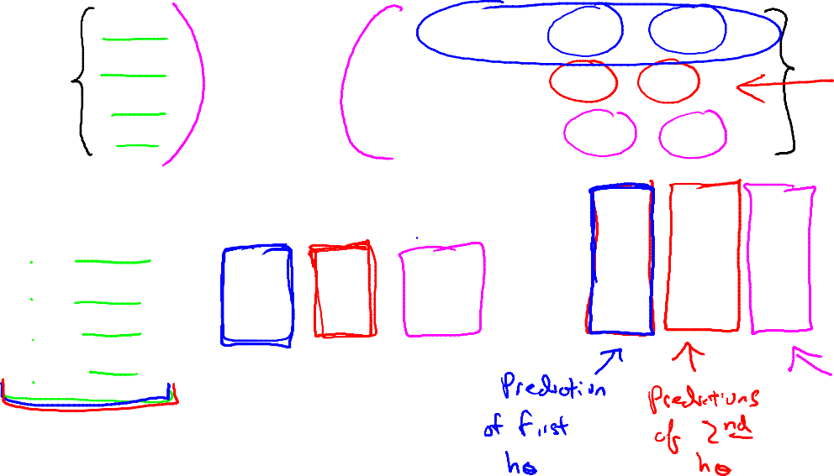
House sizes:
Have 3 competing hypotheses:
1.
2.
3.
Matrix
Matrix

Slide 20
矩阵乘法性质
Linear Algebra review (optional)
Machine Learning

Slide 21




Let and be matrices. Then in general,
(not commutative.)
E.g.

Slide 22






Let
Compute
Let
Compute

Slide 23






Identity Matrix
Denoted (or ).
Examples of identity matrices:
2 x 2
3 x 3
4 x 4
For any matrix ,

Slide 24
逆和转置
Linear Algebra review (optional)
Machine Learning

Slide 25

不是所有的数都有逆。
Matrix inverse:
If A is an m x m matrix, and if it has an inverse,
Matrices that don’t have an inverse are “singular” or “degenerate”

Slide 26





Matrix Transpose
Example:
Let be an m x n matrix, and let
Then is an n x m matrix, and

Slide 27
Welcome
Introduction
Machine Learning

Slide 28
机器学习
从人工智能工作中成长起来的
计算机的新功能
例子:
数据库挖掘
自动化/网络发展带来的大型数据集相关处理。
例如，自主直升机，手写识别，大部分自然语言处理（NLP），计算机视觉。
Self-customizing项目
例如，亚马逊，Netflix的产品推荐理解人类学习（大脑，真正的人工智能）。

Slide 29
What is machine learning
Introduction
Machine Learning

Slide 30
Machine Learning definition
亚瑟·塞缪尔（1959）。机器学习：研究领域，赋予计算机学习能力，而无需明确编程。
Tom Mitchell（1998）良定学习问题：如果一个计算机程序在T上的表现（由P衡量）随着经验E的提高而提高，那么它就可以从经验E中学习一些任务T和性能指标P。

Slide 31

“一个计算机程序就某项任务T和某项性能指标P从经验E中学习，如果它在T上的性能，根据P的衡量，随着经验E的提高而提高”
假设您的电子邮件程序监视哪些电子邮件被标记为垃圾邮件，哪些没有标记为垃圾邮件，并基于此学习如何更好地过滤垃圾邮件。这个场景中的任务T是什么？
将电子邮件分类为垃圾邮件或非垃圾邮件。
看着你给邮件贴上垃圾邮件或非垃圾邮件的标签。
正确分类为垃圾邮件/非垃圾邮件的数量（或部分）。
以上都不是——这不是机器学习的问题。

Slide 32

机器学习算法：
监督式学习
无监督学习
其他：强化学习，推荐系统。
还可以讨论：应用学习算法的实用建议。

Slide 33
Supervised Learning
Introduction
Machine Learning

Slide 34

Housing price prediction.
Price ($)
in 1000’s
Size in feet²
监督式学习
给出“正确答案”
回归：预测连续价值产出（价格）

Slide 35

乳腺癌（恶性、良性）
分类
离散值输出（0或1）
1(Y)
Malignant?
0(N)
肿瘤大小
肿瘤大小

Slide 36

厚度
细胞大小
细胞形状
Age
Tumor Size

Slide 37

你在经营一家公司，你想开发学习算法来解决这两个问题。
问题1：你有大量相同物品的库存。你想要预测这些商品在未来3个月内会卖出多少。
问题2：您希望软件检查单个客户帐户，并确定每个帐户是否已被黑客入侵/泄露。
您应该将这些问题视为分类问题还是回归问题？
将两者都视为分类问题。
将问题1视为分类问题，将问题2视为回归问题。
将问题1视为回归问题，将问题2视为分类问题。
把两者都当作回归问题。

Slide 38
Unsupervised Learning
Introduction
Machine Learning

Slide 39
Supervised Learning
x₂
x₁

Slide 40

Unsupervised Learning
x₂
x₁

Slide 41




Slide 42





Slide 43


Genes
Individuals
[Source: Daphne Koller]

Slide 44
Genes
Individuals
[Source: Daphne Koller]

Slide 45






Organize computing clusters
Social network analysis
Image credit: NASA/JPL-Caltech/E. Churchwell (Univ. of Wisconsin, Madison)
Market segmentation
Astronomical data analysis
Notes:
Astronomical data analysis image obtained from NASA website.
http://www.nasa.gov/multimedia/imagegallery/image_feature_874.html
RCW 79 is seen in the southern Milky Way, 17,200 light-years from Earth in the constellation Centaurus. The bubble is 70-light years in diameter, and probably took about one million years to form from the radiation and winds of hot young stars. The balloon of gas and dust is an example of stimulated star formation. Such stars are born when the hot bubble expands into the interstellar gas and dust around it. RCW 79 has spawned at least two groups of new stars along the edge of the large bubble. Some are visible inside the small bubble in the lower left corner. Another group of baby stars appears near the opening at the top. NASA's Spitzer Space Telescope easily detects infrared light from the dust particles in RCW 79. The young stars within RCW79 radiate ultraviolet light that excites molecules of dust within the bubble. This causes the dust grains to emit infrared light that is detected by Spitzer and seen here as the extended red features. Image credit: NASA/JPL-Caltech/E. Churchwell (Univ. of Wisconsin, Madison)
--------------------
From NASA use guidelines:
http://www.nasa.gov/multimedia/guidelines/index.html
Using NASA Imagery and Linking to NASA Web Sites 10.13.05 Still Images, Audio Files and Video
NASA still images, audio files and video generally are not copyrighted. You may use NASA imagery, video and audio material for educational or informational purposes, including photo collections, textbooks, public exhibits and Internet Web pages. This general permission extends to personal Web pages.
This general permission does not extend to use of the NASA insignia logo (the blue "meatball" insignia), the retired NASA logotype (the red "worm" logo) and the NASA seal. These images may not be used by persons who are not NASA employees or on products (including Web pages) that are not NASA sponsored.
If the NASA material is to be used for commercial purposes, especially including advertisements, it must not explicitly or implicitly convey NASA's endorsement of commercial goods or services. If a NASA image includes an identifiable person, using the image for commercial purposes may infringe that person's right of privacy or publicity, and permission should be obtained from the person. Any questions regarding application of any NASA image or emblem should be directed to:
Photo Department NASA Headquarters 300 E St. SW Washington, DC 20546 Tel: (202)358-1900 Fax: (202)358-4333
Linking to NASA Web Sites
NASA Web sites are not copyrighted, and may be linked to from other Web sites, including individuals' personal Web sites, without explicit permission from NASA. However, such links may not explicitly or implicitly convey NASA's endorsement of commercial goods or services.
NASA images may be used as graphic "hot links" to NASA Web sites, provided they are used within the guidelines above. This permission does not extend to use of the NASA insignia, the retired NASA logotype or the NASA seal.
Restrictions
Please be advised that:
1) NASA does not endorse or sponsor any commercial product, service, or activity.
2) The use of the NASA name, initials, any NASA emblems (including the NASA insignia, the NASA logo and the NASA seal) which would express or imply such endorsement or sponsorship is strictly prohibited.
3) Use of the NASA name or initials as an identifying symbol by organizations other than NASA (such as on foods, packaging, containers, signs, or any promotional material) is prohibited.
4) NASA does permit the use of the NASA logo and insignia on novelty and souvenir-type items. However, such items may be sold and manufactured only after a proposal has been submitted to and approved by a Visual Identity representative from the Public Outreach Division (Phone: 202/358-1750) in accordance with 14 CFR (Code of Federal Regulations) Part 1221. Permission is granted on a nonexclusive basis as it is not NASA's policy to grant exclusive rights to use any of the agency identities.
5) No approval for use is authorized by NASA when the use can be construed as an endorsement by NASA of a product, service or activity.
6) NASA emblems should be reproduced only from original reproduction proofs, transparencies, or computer files available from NASA Headquarters. Please be advised that approval must be granted by a Visual Identity representative from the Public Outreach Division ( Tel: 202/358-1750) before any reproduction materials can be obtained.

Slide 46
鸡尾酒会问题算法
[W,s,v] = svd((repmat(sum(x.*x,1),size(x,1),1).*x)*x');
[Source: Sam Roweis, Yair Weiss & Eero Simoncelli]

Slide 47

在下面的例子中，你会使用无监督学习算法来解决哪个问题？（检查所有适用的）
给定标记为垃圾邮件/非垃圾邮件的电子邮件，学习垃圾邮件过滤器。
给定一组在网络上找到的新闻文章，将它们归类为一组关于同一故事的文章。
给定客户数据数据库，自动发现细分市场并将客户分组到不同的细分市场。
给定一个诊断为患有糖尿病或没有糖尿病的患者数据集，学习将新患者分类为患有糖尿病或没有糖尿病。

Slide 48
模型表示
Linear regression with one variable
Machine Learning

Slide 49

Housing Prices
(Portland, OR)
Price
(in 1000s of dollars)
Size (feet²)
监督式学习
给出数据中每个例子的“正确答案”。
回归问题
预测实值输出

Slide 50

房价
的训练集
Size in feet² (x) | Price ($) in 1000's (y)
2104 | 460
1416 | 232
1534 | 315
852 | 178
… | …
符号:
m =训练样例的个数
X =“输入”变量/特征
Y =“输出”变量/“目标”变量

Slide 51

Training Set
How do we represent h ?
Learning Algorithm
Size of house
h
Estimated price
单变量线性回归。

Slide 52
Cost function
Linear regression with one variable
Machine Learning

Slide 53



Training Set
Size in feet² (x) | Price ($) in 1000's (y)
2104 | 460
1416 | 232
1534 | 315
852 | 178
… | …
Hypothesis:
‘s: Parameters
How to choose ‘s ?

Slide 54




y
x
Idea: Choose so that is close to for our training examples

Slide 55





Slide 56
Cost function intuition I
Linear regression with one variable
Machine Learning

Slide 57







Simplified
Hypothesis(假设):
Parameters:
Cost Function:
Goal:

Slide 58






(for fixed , this is a function of x)
(function of the parameter )
y
x

Slide 59



(for fixed , this is a function of x)
(function of the parameter )
y
x

Slide 60


(for fixed , this is a function of x)
(function of the parameter )
y
x

Slide 61
Cost function intuition II
Linear regression with one variable
Machine Learning

Slide 62


Hypothesis:
Parameters:
Cost Function:
Goal:

Slide 63





(for fixed , this is a function of x)
(function of the parameters )
Price ($)
in 1000’s
Size in feet² (x)

Slide 64




Slide 65



(for fixed , this is a function of x)
(function of the parameters )

Slide 66



(for fixed , this is a function of x)
(function of the parameters )

Slide 67



(for fixed , this is a function of x)
(function of the parameters )

Slide 68



(for fixed , this is a function of x)
(function of the parameters )

Slide 69
梯度下降法
Linear regression with one variable
Machine Learning

Slide 70


Have some function
Want
Outline:
Start with some
Keep changing to reduce until we hopefully end up at a minimum

Slide 71


J(θ₀,θ₁)
θ₁
θ₀

Slide 72

J(θ₀,θ₁)
θ₁
θ₀

Slide 73





Gradient descent algorithm
Correct: Simultaneous update
Incorrect:

Slide 74
Gradient descent intuition
Linear regression with one variable
Machine Learning

Slide 75



Gradient descent algorithm

Slide 76


Slide 77


学习率太大或者太小的影响：
If α is too small, gradient descent can be slow.
If α is too large, gradient descent can overshoot the minimum. It may fail to converge, or even diverge.

Slide 78


at local optima（局部最小值）
Current value of

Slide 79

即使学习率α固定，梯度下降也能收敛到局部最小值。
当我们接近局部最小值时，梯度下降会自动采取更小的步长。所以不需要随时间减小α。

Slide 80
线性回归的梯度下降
Linear regression with one variable
Machine Learning

Slide 81


Gradient descent algorithm
Linear Regression Model

Slide 82





Slide 83



Gradient descent algorithm
update
and
simultaneously

Slide 84

J(θ₀,θ₁)
θ₁
θ₀

Slide 85
J(θ₀,θ₁)
θ₁
θ₀

Slide 86


Slide 87



(for fixed , this is a function of x)
(function of the parameters )

Slide 88

(for fixed , this is a function of x)
(function of the parameters )

Slide 89


(for fixed , this is a function of x)
(function of the parameters )

Slide 90


(for fixed , this is a function of x)
(function of the parameters )

Slide 91

(for fixed , this is a function of x)
(function of the parameters )

Slide 92

(for fixed , this is a function of x)
(function of the parameters )

Slide 93


(for fixed , this is a function of x)
(function of the parameters )

Slide 94

(for fixed , this is a function of x)
(function of the parameters )

Slide 95



(for fixed , this is a function of x)
(function of the parameters )

Slide 96

“Batch” Gradient Descent
“Batch”: Each step of gradient descent uses all the training examples.
“批处理”：梯度下降的每一步使用所有的训练样例。

Slide 97
多个特性
Linear Regression with multiple variables
Machine Learning

Slide 98


Multiple features (variables).
Size (feet²) | Price ($1000)
2104 | 460
1416 | 232
1534 | 315
852 | 178
… | …

Slide 99
Multiple features (variables).
Size (feet²) | Number of bedrooms | Number of floors | Age of home (years) | Price ($1000)
2104 | 5 | 1 | 45 | 460
1416 | 3 | 2 | 40 | 232
1534 | 3 | 2 | 30 | 315
852 | 2 | 1 | 36 | 178
… | … | … | … | …

Slide 100




Multiple features (variables).
Size (feet²) | Number of bedrooms | Number of floors | Age of home (years) | Price ($1000)
2104 | 5 | 1 | 45 | 460
1416 | 3 | 2 | 40 | 232
1534 | 3 | 2 | 30 | 315
852 | 2 | 1 | 36 | 178
… | … | … | … | …
Notation:
= number of features
= input (features) of training example.输入的值
= value of feature in training example.值的特征
Notes:
Pop-up Quiz

Slide 101

Hypothesis:
Previously:

Slide 102


为了方便标记，定义
多元线性回归

Slide 103
多变量梯度下降
Linear Regression with multiple variables
Machine Learning

Slide 104







Hypothesis:
Parameters:
Cost function:
Gradient descent:
Repeat
(simultaneously update for every )

Slide 105












New algorithm :
Gradient Descent
Repeat
Previously (n=1):
Repeat
(simultaneously update for
)
(simultaneously update )

Slide 106
实践中的梯度下降1：特征缩放
Linear Regression with multiple variables
Machine Learning

Slide 107








Feature Scaling
Idea: Make sure features are on a similar scale.
E.g. = size (0-2000 feet²)
= number of bedrooms (1-5)
size (feet²)
number of bedrooms

Slide 108


Feature Scaling
Get every feature into approximately a range.

Slide 109






Mean normalization
Replace with to make features have approximately zero mean (Do not apply to ).
E.g.

Slide 110
练习中的梯度下降II：学习率
Linear Regression with multiple variables
Machine Learning

Slide 111



Gradient descent
“调试”：如何确保梯度下降正常工作。
How to choose learning rate .

Slide 112



确保梯度下降正常工作。
自动收敛测试示例：
如果声明收敛 一次减少
No. of iterations

Slide 113


Making sure gradient descent is working correctly.
Gradient descent not working.
Use smaller .
No. of iterations
No. of iterations
No. of iterations
对于 足够小， 应该在每次迭代中减少。
但如果 它太小，梯度下降可能会缓慢收敛。

Slide 114

Summary:
If is too small:收敛速度慢.
If is too large: 可能不会在每次迭代中减少；可能不会收敛。
To choose , try

Slide 115
特征与多项式回归
Linear Regression with multiple variables
Machine Learning

Slide 116


Housing prices prediction

Slide 117







Polynomial regression
Price
(y)
Size (x)

Slide 118

Choice of features
Price
(y)
Size (x)

Slide 119
正规方程
Linear Regression with multiple variables
Machine Learning

Slide 120


梯度下降法
Normal equation: Method to solve for
analytically.

Slide 121








Intuition: If 1D
正规方程：是一种在线性回归问题中，通过直接求解解析解（analytical solution）来找到模型参数的方法。它不需要像梯度下降那样迭代优化，而是通过一次性计算得到最优解。
(for every )
Solve for

Slide 122












Examples:
 | Size (feet²) | Number of bedrooms | Number of floors | Age of home (years) | Price ($1000)
1 | 2104 | 5 | 1 | 45 | 460
1 | 1416 | 3 | 2 | 40 | 232
1 | 1534 | 3 | 2 | 30 | 315
1 | 852 | 2 | 1 | 36 | 178
Size (feet²) | Number of bedrooms | Number of floors | Age of home (years) | Price ($1000)
2104 | 5 | 1 | 45 | 460
1416 | 3 | 2 | 40 | 232
1534 | 3 | 2 | 30 | 315
852 | 2 | 1 | 36 | 178
Notes:
Pop-up Quiz

Slide 123




Examples:
 | Size (feet²) | Number of bedrooms | Number of floors | Age of home (years) | Price ($1000)
1 | 2104 | 5 | 1 | 45 | 460
1 | 1416 | 3 | 2 | 40 | 232
1 | 1534 | 3 | 2 | 30 | 315
1 | 852 | 2 | 1 | 36 | 178
1
Size (feet²) | Number of bedrooms | Number of floors | Age of home (years) | Price ($1000)
2104 | 5 | 1 | 45 | 460
1416 | 3 | 2 | 40 | 232
1534 | 3 | 2 | 30 | 315
852 | 2 | 1 | 36 | 178
3000 | 4 | 1 | 38 | 540
Notes:
Pop-up Quiz

Slide 124





examples ; features.
E.g. If

Slide 125



is inverse of matrix .
Octave:
pinv(X’*X)*X’*y

Slide 126

training examples, features.
Gradient Descent
Normal Equation
Need to choose .
Needs many iterations.
No need to choose .
Don’t need to iterate.
Works well even when is large.
Need to compute
Slow if is very large.

